Slide 1

Supervised by
ENG.LAMIA
Gerges Tharwat
Tadros Eshak
Yasmine Ayman
Maria Samy
Mark Fady

Slide 2

AGENDA
1.Use case
2.Class
3.Object
4.Activity
5.Sequence
6.Estate chart
7.Components
8.Deployment
9.Collaboration

Slide 3
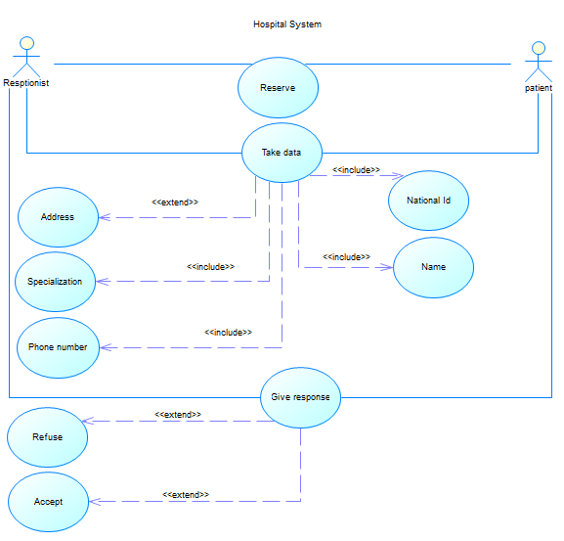
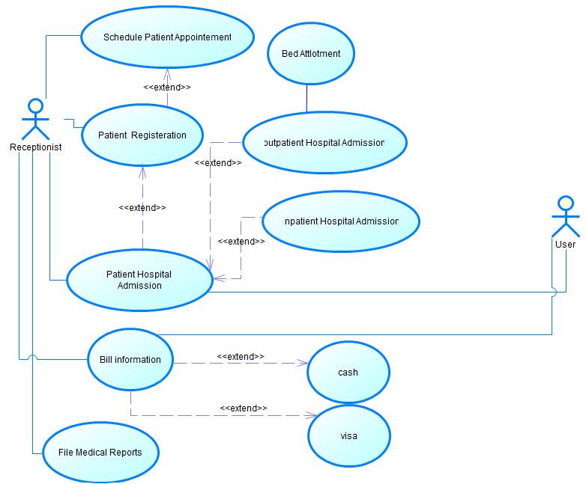
Use cASE Diagrams

Slide 4
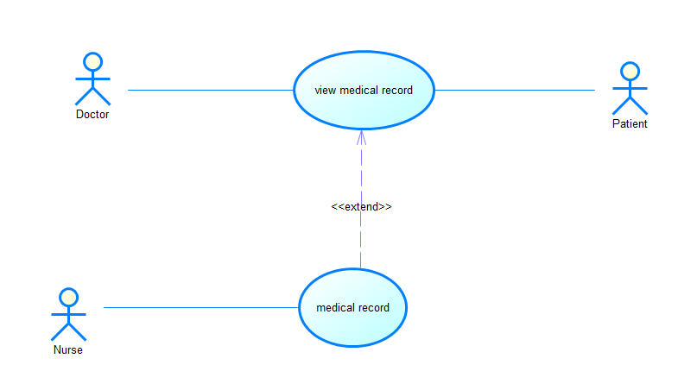
Use cASE Diagrams [Cont]

Slide 5
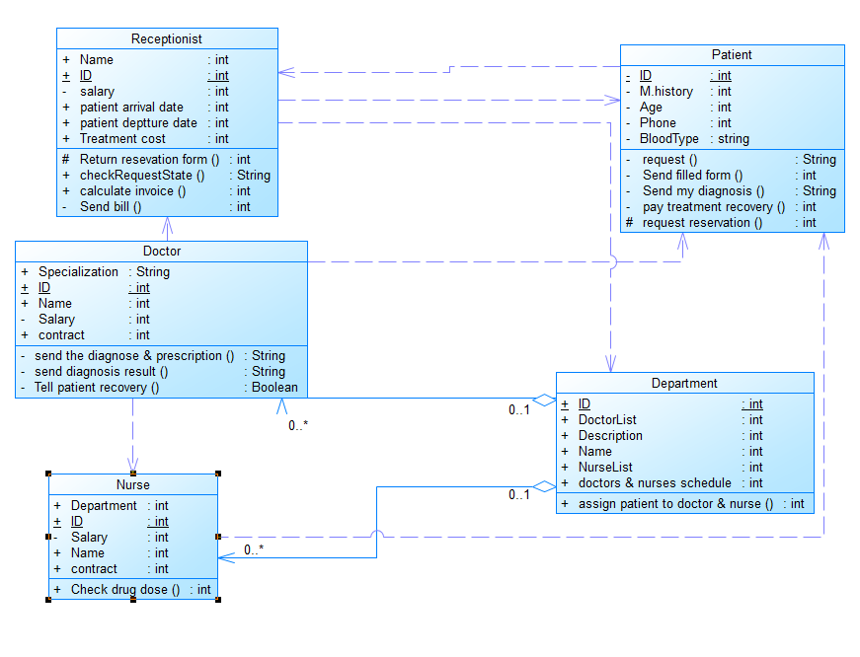
Class Diagram

Slide 6
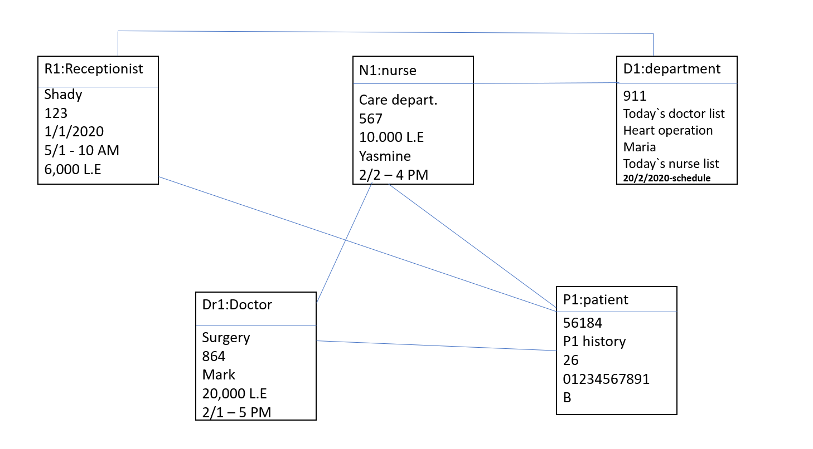
OBJECT Diagram

Slide 7
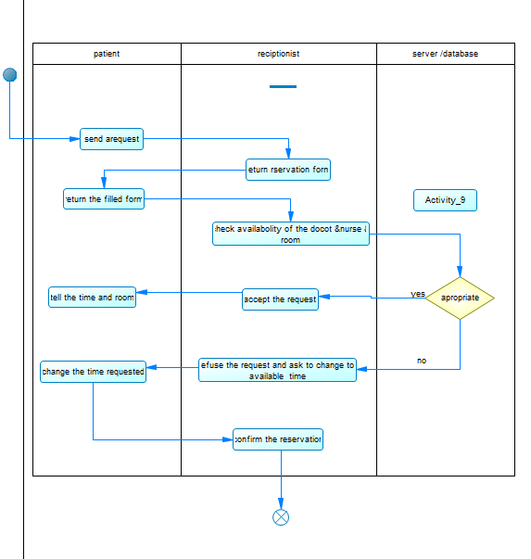
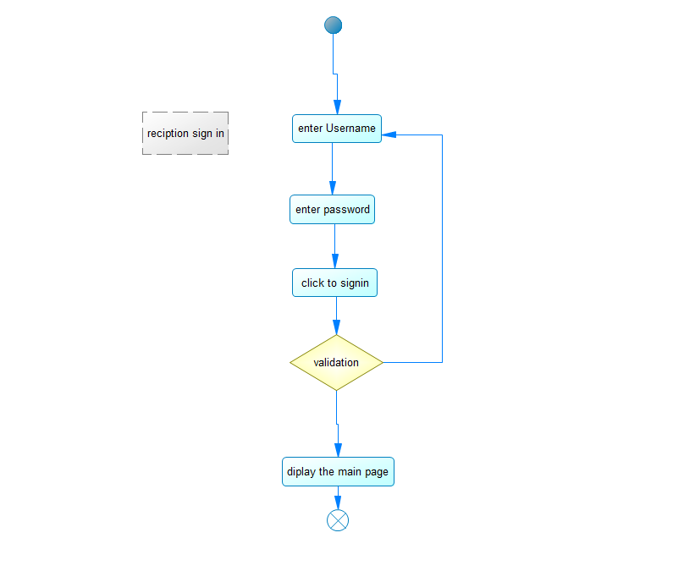
Activity Diagrams

Slide 8
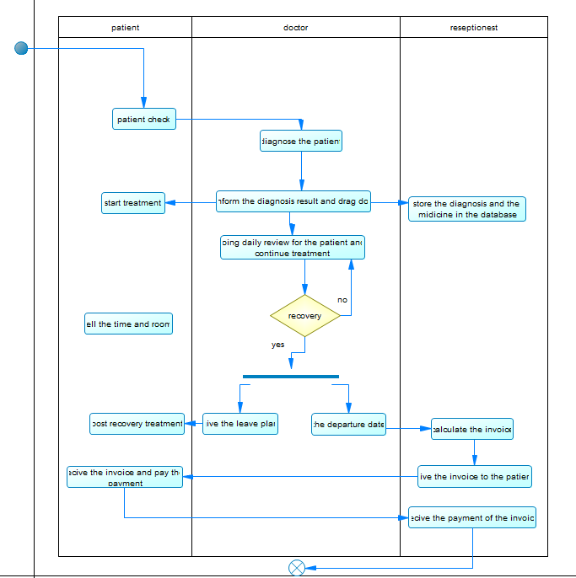
Activity Diagram [cont]

Slide 9
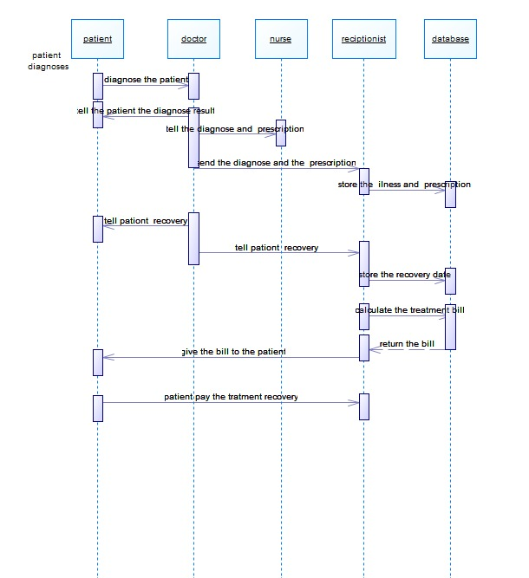
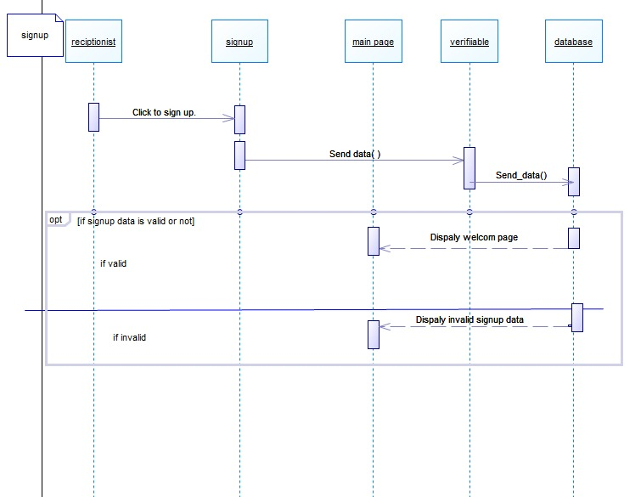
SeQuence Diagram

Slide 10
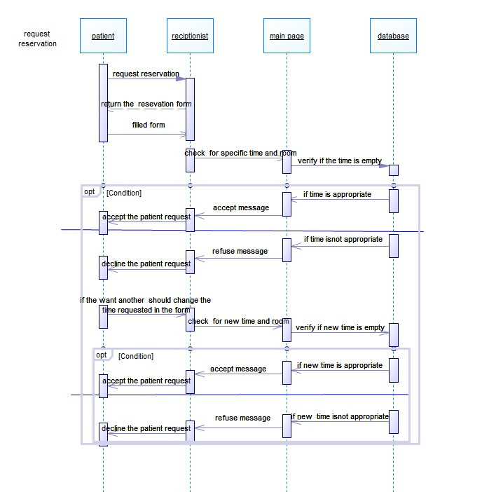
SeQuence Diagram[cont]

Slide 11
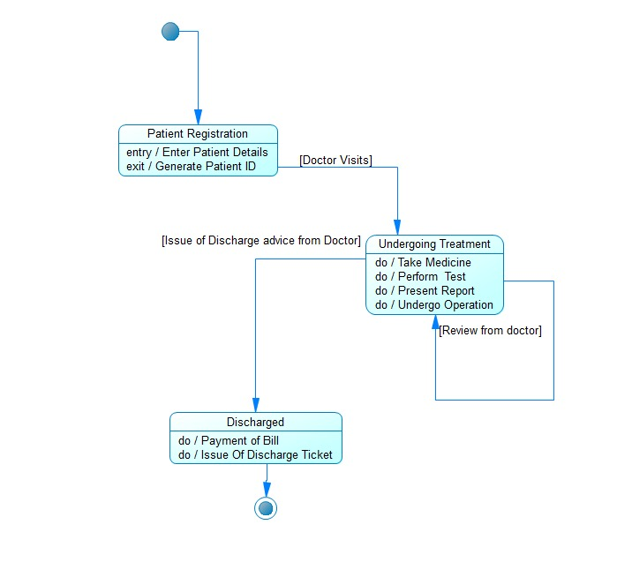
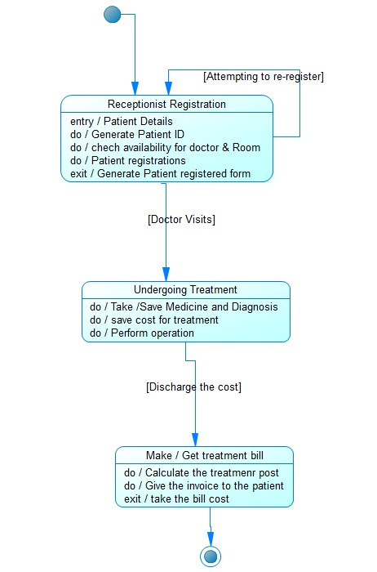
Estate Diagram

Slide 12
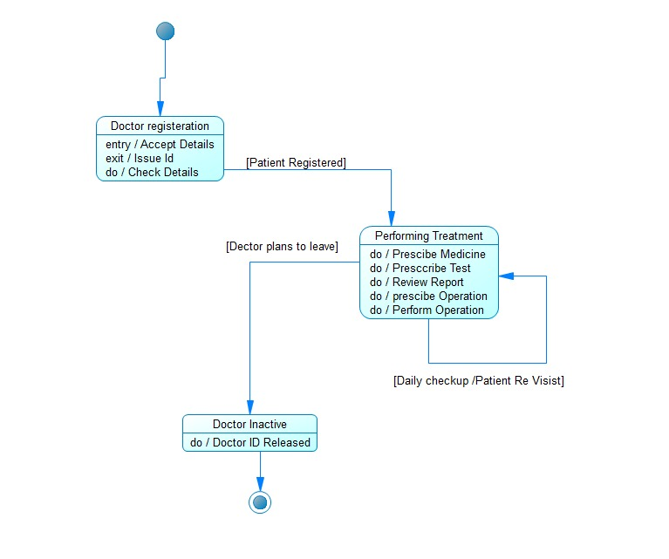
Estate Diagram[cont]

Slide 13
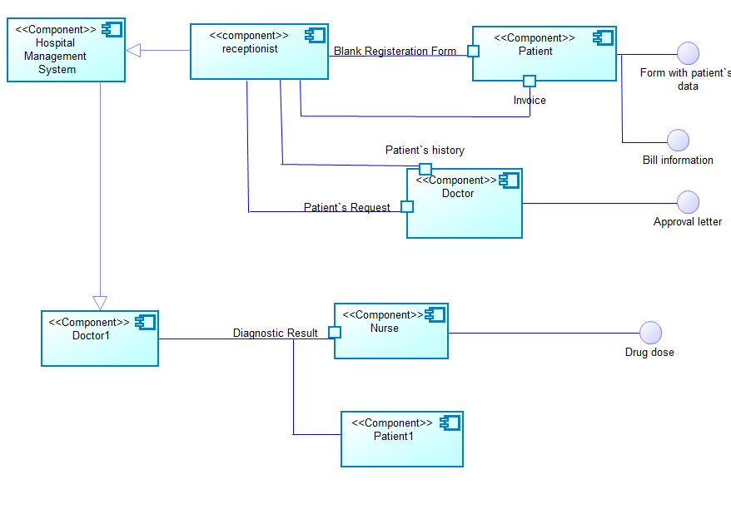
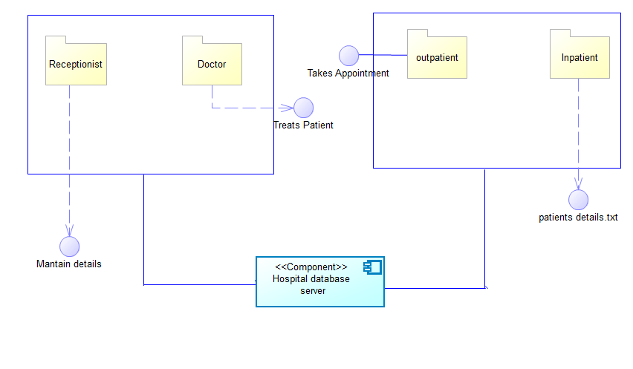
cOMPONENT Diagram

Slide 14
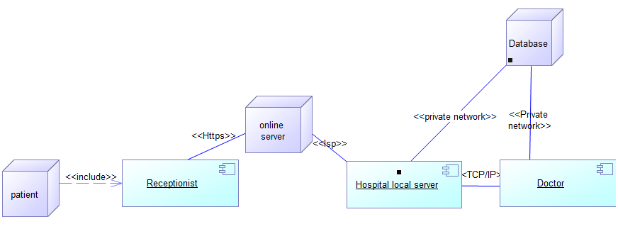
dEPLOYMENT Diagram

Slide 15
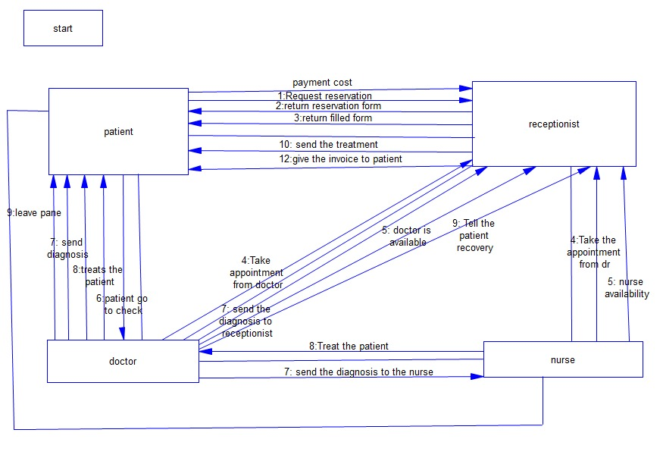
collaboration Diagram

